Slide 1
Parsing issues

Slide 2
Parse Tree & Derivations
A parse tree is a graphical representation of a derivation that filters out the order in which productions are applied to replace non-terminals .
Each interior node of a parse tree represents the application of a production.
The interior node is labeled with the non-terminal A in the head of the production.
The children of the node are labeled, from left to right, by the symbols in the body of the production by which this A was replaced during the derivation.

Slide 3
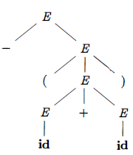
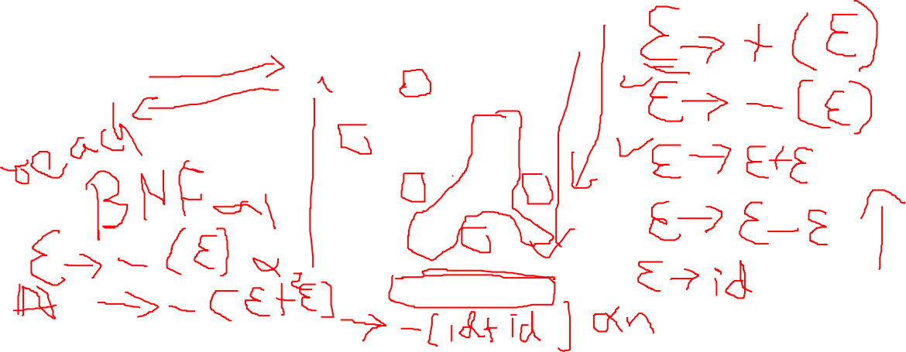
Parse Tree & Derivations..
Ex: -(id + id)
The leaves of a parse tree are labeled by non-terminals or terminals and, read from left to right constitute a sentential form, called the yield or frontier of the tree.

Slide 4
id + id * id
E+id*id
E+E* id
E*id
E*E
E
/// E--> E+E|E-E|E*E
id + id * id
id+id*E
id+E*E
id*E
E*E
E
/// E--> E+E|E-E|E*E

Slide 5
Parse Tree & Derivations…
A derivation starting with a single non-terminal, A ⇒ α₁ ⇒ α₂ ... ⇒ α_{n}
It is easy to write a parse tree with A as the root and α_{n} as the leaves.
The LHS of each production is a non-terminal in the frontier of the current tree so replace it with the RHS to get the next tree.
There can be many derivations that wind up with the same final tree.
But for any parse tree there is a unique leftmost derivation the produces that tree.
Similarly, there is a unique rightmost derivation that produces the tree.

Slide 6

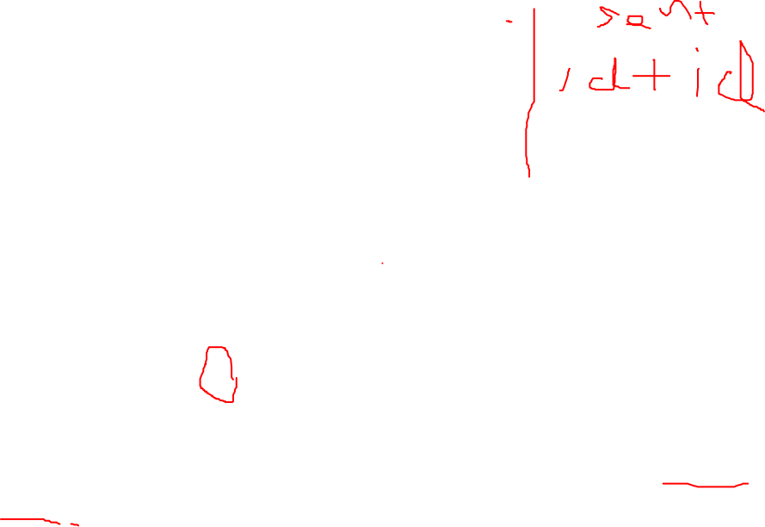
Ambiguity
A grammar that produces more than one parse tree for some sentence is said to be ambiguous.
Alternatively, an ambiguous grammar is one that produces more than one leftmost derivation or more than one rightmost derivation for the same sentence.
Ex Grammar E → E + E | E * E | ( E ) | id
It is ambiguous because we have seen two parse trees for id + id * id

Slide 7
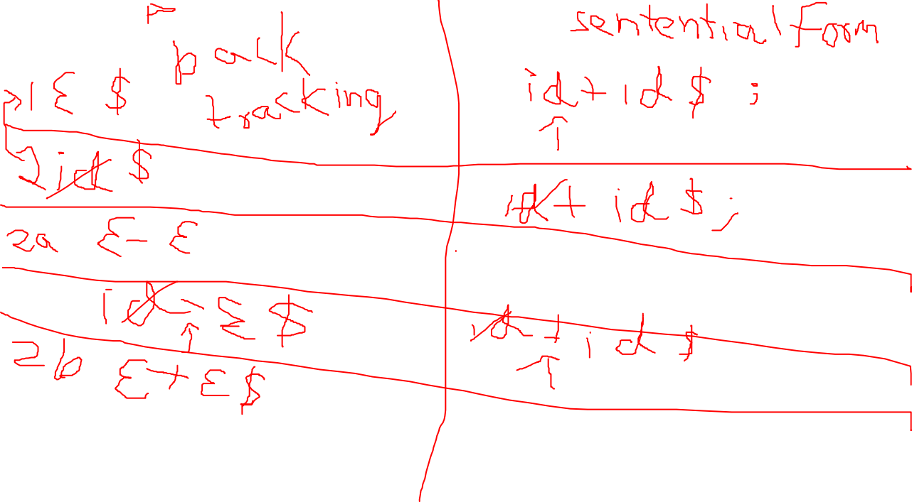

Slide 8

Id+id*id
E
E
E
+
E
E
*
E
E
E
E
E
*
+

Slide 9
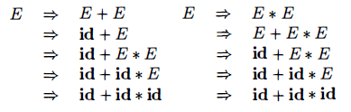
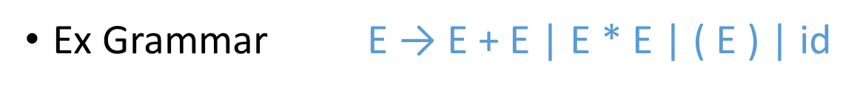
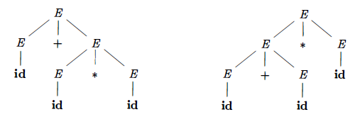
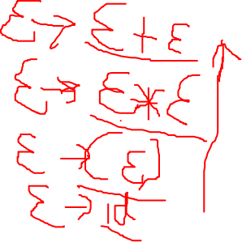
Ambiguity..
There must be at least two leftmost derivations.
So two parse trees are

Slide 10
Associativity
Left associative
Right associative
id+id+id
a=b+c

Slide 11

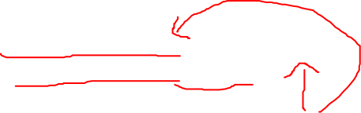
Eliminating Ambiguity
An ambiguous grammar can be rewritten to eliminate the ambiguity.
Ex. Eliminating the ambiguity from the following dangling-else grammar:
Compound conditional statement
if E₁ then S₁ else if E₂ then S₂ else S₃

Slide 12
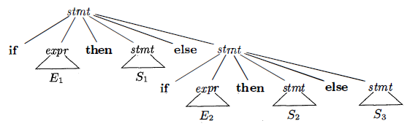
Eliminating Ambiguity..
Parse tree for this compound conditional statement:
This Grammar is ambiguous since the following string has the two parse trees:
if E₁ then if E₂ then S₁ else S₂

Slide 13
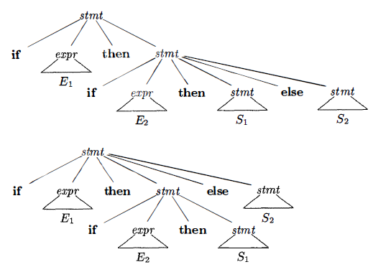
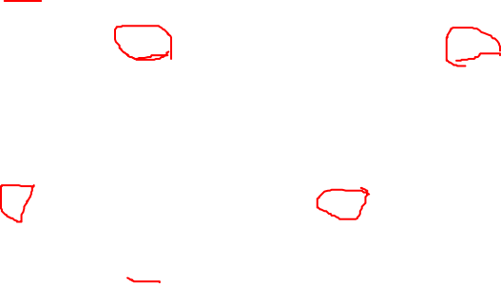
Eliminating Ambiguity…

Slide 14
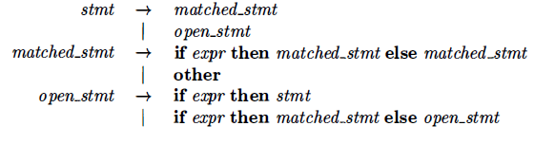
Eliminating Ambiguity…
We can rewrite the dangling-else grammar with the idea:
A statement appearing between a then and an else must be matched that is, the interior statement must not end with an unmatched or open then.
A matched statement is either an if-then-else statement containing no open statements or it is any other kind of unconditional statement.

Slide 15
Goal Start
E+E|E - E
E/E| E*E

Slide 16
Parsing Techniques
Top-down parsers
Start at the root of the parse tree and grow towards leaves.
Pick a production and try to match the input

Slide 17
Parsing Techniques
Top-down parsers
Bad “pick” ⇒ may need to backtrack
Some grammars are backtrack-free.

Slide 18
Parsing Techniques
Top-down parsers
Bad “pick” ⇒ may need to backtrack
Some grammars are backtrack-free.

Slide 19
Parsing Techniques
Bottom-up parsers
Start at the leaves and grow toward root
As input is consumed, encode possibilities in an internal state.
Notes:
end of lec 12

Slide 20
Parsing Techniques
Bottom-up parsers
Start in a state valid for legal first tokens
Bottom-up parsers handle a large class of grammars

Slide 21
Top-Down Parser
A top-down parser starts with the root of the parse tree.
The root node is labeled with the goal symbol of the grammar

Slide 22
Top-Down Parsing Algorithm
Construct the root node of the parse tree
Repeat until the fringe of the parse tree matches input string

Slide 23
Top-Down Parsing
At a node labeled A, select a production with A on its lhs
for each symbol on its rhs, construct the appropriate child

Slide 24
Top-Down Parsing
When a terminal symbol is added to the fringe and it does not match the fringe, backtrack
Find the next node to be expanded

Slide 25
Top-Down Parsing
The key is picking right production in step 1.
That choice should be guided by the input string

Slide 26
Lets do a simple top down parsing of a grammar after ambiguity is removed

Slide 27
Expression Grammar
1 | Goal | → | expr
2 | expr | → | expr + term
3 |  | | | expr - term
4 |  | | | term
5 | term | → | term * factor
6 |  | | | term ∕ factor
7 |  | | | factor
8 | factor | → | number
9 |  | | | id
10 |  | | | ( expr )

Slide 28
Top-Down Parsing
Let’s try parsing x – 2 * y

Slide 29
P | Sentential Form | input
- | Goal | ↑x – 2 * y
1 | expr | ↑x – 2 * y
2 | expr + term | ↑x – 2 * y
4 | term + term | ↑x – 2 * y
7 | factor + term | ↑x – 2 * y
9 | <id,x> + term | ↑x – 2 * y
9 | <id,x> + term | x ↑– 2 * y

Slide 30
P | Sentential Form | input
- | Goal | ↑x – 2 * y
1 | expr | ↑x – 2 * y
2 | expr + term | ↑x – 2 * y
4 | term + term | ↑x – 2 * y
7 | factor + term | ↑x – 2 * y
9 | <id,x> + term | ↑x – 2 * y
9 | <id,x> + term | x ↑– 2 * y
This worked well except that “–” does not match “+”

Slide 31
P | Sentential Form | input
- | Goal | ↑x – 2 * y
1 | expr | ↑x – 2 * y
2 | expr + term | ↑x – 2 * y
4 | term + term | ↑x – 2 * y
7 | factor + term | ↑x – 2 * y
9 | <id,x> + term | ↑x – 2 * y
9 | <id,x> + term | x ↑– 2 * y
The parser must backtrack to here

Slide 32
P | Sentential Form | input
- | Goal | ↑x – 2 * y
1 | expr | ↑x – 2 * y
2 | expr – term | ↑x – 2 * y
4 | term – term | ↑x – 2 * y
7 | factor – term | ↑x – 2 * y
9 | <id,x> – term | ↑x – 2 * y
9 | <id,x> – term | x ↑– 2 * y
This time the “–” and “–” matched

Slide 33
P | Sentential Form | input
- | Goal | ↑x – 2 * y
1 | expr | ↑x – 2 * y
2 | expr – term | ↑x – 2 * y
4 | term – term | ↑x – 2 * y
7 | factor – term | ↑x – 2 * y
9 | <id,x> – term | ↑x – 2 * y
9 | <id,x> – term | x ↑– 2 * y
- | <id,x> – term | x – ↑2 * y
We can advance past “–” to look at “2”

Slide 34
P | Sentential Form | input
- | Goal | ↑x – 2 * y
1 | expr | ↑x – 2 * y
2 | expr – term | ↑x – 2 * y
4 | term – term | ↑x – 2 * y
7 | factor – term | ↑x – 2 * y
9 | <id,x> – term | ↑x – 2 * y
9 | <id,x> – term | x ↑– 2 * y
- | <id,x> – term | x – ↑2 * y
Now, we need to expand “term”

Slide 35
P | Sentential Form | input
- | <id,x> – term | x – ↑2 * y
7 | <id,x> – factor | x – ↑2 * y
9 | <id,x> – <num,2> | x – ↑2 * y
- | <id,x> – <num,2> | x – 2 ↑* y
“2” matches “2”
We have more input but no non-terminals left to expand

Slide 36
P | Sentential Form | input
- | <id,x> – term | x – ↑2 * y
7 | <id,x> – factor | x – ↑2 * y
9 | <id,x> – <num,2> | x – ↑2 * y
- | <id,x> – <num,2> | x – 2 ↑* y
The expansion terminated too soon
⇒ Need to backtrack

Slide 37
P | Sentential Form | input
- | <id,x> – term | x – ↑2 * y
5 | <id,x> – term * factor | x – ↑2 * y
7 | <id,x> – factor * factor | x – ↑2 * y
8 | <id,x> – <num,2> * factor | x – ↑2 * y
- | <id,x> – <num,2> * factor | x – 2 ↑ * y
- | <id,x> – <num,2> * factor | x – 2 * ↑ y
9 | <id,x> – <num,2> * <id,y> | x – 2 * ↑ y
- | <id,x> – <num,2> * <id,y> | x – 2 * y ↑
Success! We matched and consumed all the input

Slide 38
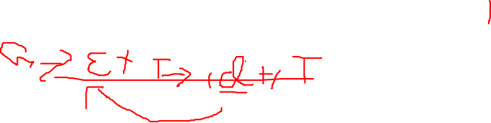
Another Possible Parse
P | Sentential Form | input
- | Goal | ↑x – 2 * y
1 | expr | ↑x – 2 * y
2 | expr +term | ↑x – 2 * y
2 | expr +term +term | ↑x – 2 * y
2 | expr +term +term +term | ↑x – 2 * y
2 | expr +term +term +term +.... | ↑x – 2 * y
Wrong choice of expansion leads to non-termination
consuming no input!!
Parser must make the right choice

Slide 39
G→E+T→T +T→F+T→id+T
G→E-T
G→E+T→E+T +T→T+T +T→id+T+T
G→ E+T-->E+T+T→E+T+T+T
E+T
E+T+T
E+T+T+T
E+T+T+T+T
E+T+T+T+T+T

Slide 40
Left Recursion
Top-down parsers cannot handle left-recursive grammars

Slide 41
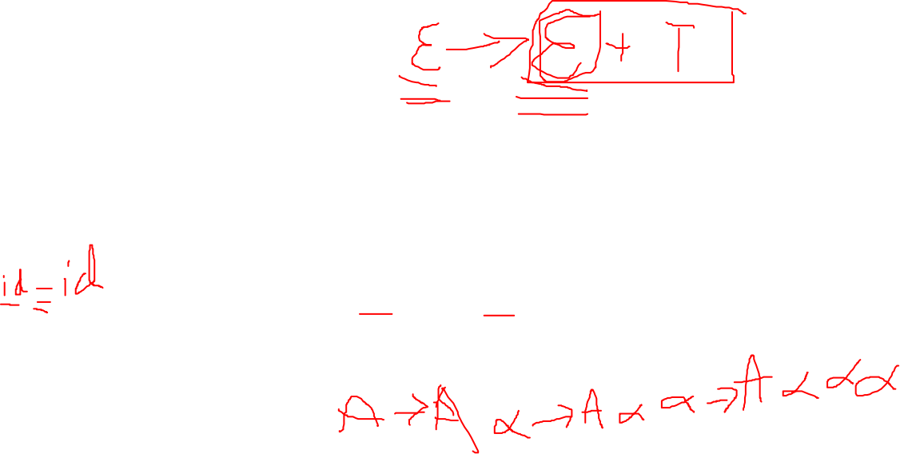
Left Recursion
Formally, A grammar is left recursive if ∃ A ∈ NT such that ∃ a derivation A ⇒* A α, for some string α ∈ (NT ∪ T)*

Slide 42
Left Recursion
Our expression grammar is left recursive.
This can lead to non-termination in a top-down parser

Slide 43
Left Recursion
Non-termination is bad in any part of a compiler!

Slide 44
Left Recursion
For a top-down parser, any recursion must be a right recursion
We would like to convert left recursion to right recursion

Slide 45
Eliminating Left Recursion
To remove left recursion, we transform the grammar
Subsitution algorithm

Slide 46
Ambiguity
Associativity
Precedence
Left associative
Right associative
Precedence with order of implementation of production
E→E+E
E→E*E
E→id
E→ E+T |T
T→T*F|F
F→id
Id has more precedence than F
F has more precedence than T
T has more precedence than E
E has the least precedence
Left factoring
In A→BCD
A→BCE
BC either terminals or non terminals are same
Left recursion
A->Aa
Look ahead
Left recursive grammar
Right recursive grammar
Substitution algorithm

Slide 47
Eliminating Left Recursion
Consider a grammar fragment: A → A α | β where neither α nor β starts with A.

Slide 48
Eliminating Left Recursion
We can rewrite this as: A → β A'
A' → α A' | ε where A' is a new non-terminal

Slide 49
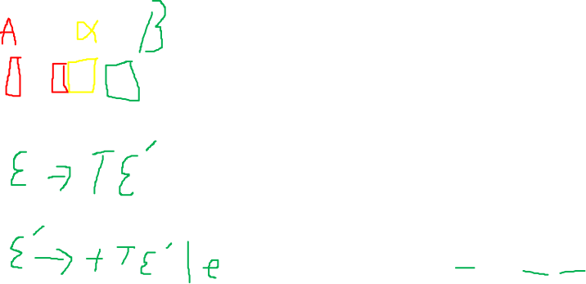
E→E+T|T
A → A α | β
A → β A'
A' → α A' | ε

Slide 50
E→E+T
E→T
T→id
Id
Id+id
Id+id+id
1st step make non recursive NT
E→T
E_→+T
2nd step make E_ reachable
E→TE_
E_→+T
T→id
Id
Id+id
3rd step make E_ right recursive
E→TE_
E_→+TE_
T→id
4th step insert epilson to terminate right recursion of E_
E—>TE_
E_→+TE_|epilson

Slide 51
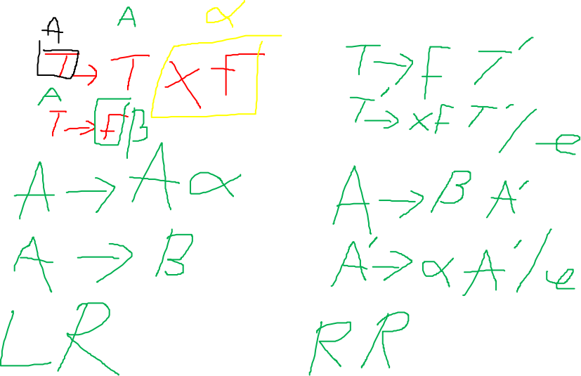
T→T*F|F
F→id

Slide 52
Eliminating Left Recursion
We can rewrite this as: A → β A'
A' → α A' | ε where A' is a new non-terminal

Slide 53
Eliminating Left Recursion
A → β A ' A' → α A' | ε
This accepts the same language but uses only right recursion

Slide 54
Eliminating Left Recursion
The expression grammar we have been using contains two cases of left- recursion

Slide 55
Eliminating Left Recursion
expr | → | expr + term
 | | | expr – term
 | | | term
term | → | term * factor
 | | | term ∕ factor
 | | | factor

Slide 56
Eliminating Left Recursion
Applying the transformation yields
expr | → | term expr'
expr' | → | + term expr'
 | | | – term expr'
 | | | ε

Slide 57
Eliminating Left Recursion
Applying the transformation yields
term | → | factor term'
term' | → | * factor term'
 | | | ∕ factor term'
 | | | ε

Slide 58
Eliminating Left Recursion
These fragments use only right recursion
They retain the original left associativity
A top-down parser will terminate using them.

Slide 59
1 | Goal | → | expr
2 | expr | → | term expr'
3 | expr' | → | + term expr'
4 |  | | | – term expr'
5 |  | | | ε
6 | term | → | factor term'
7 | term' | → | * factor term'
8 |  | | | ∕ factor term'
9 |  | | | ε
10 | factor | → | number
11 |  | | | id
12 |  | | | ( expr )

Slide 60
Elimination of Left Recursion
A grammar is left recursive if it has a non-terminal A such that there is a derivation A ⇒⁺ Aα for some string α
Top-down parsing methods cannot handle left-recursive grammars, so a transformation is needed to eliminate left recursion.
We already seen removal of Immediate left recursion i.e
A → Aα + β A → βA’
A’ → αA’ | ɛ

Slide 61
Elimination of Left Recursion..
Immediate left recursion can be eliminated by the following technique, which works for any number of A-productions.
A → Aα₁ | Aα₂ | … | Aα_{m} | β₁ | β₂ | … | β_{n}
Then the equivalent non-recursive grammar is
A → β₁A’ | β₂A’ | … | β_{n}A’
A’ → α₁A’ | α₂A’ | … | α_{m}A’ | ɛ
The non-terminal A generates the same strings as before but is no longer left recursive.

Slide 62
Elimination of Left Recursion...
This procedure eliminates all left recursion from the A and A' productions (provided no α_{i} is ɛ) , but it does not eliminate left recursion involving derivations of two or more steps.
Ex. Consider the grammar:
S → A a | b
A → A c | S d | ɛ
The non-terminal S is left recursive because S ⇒ Aa ⇒ Sda , but it is not immediately left recursive.

Slide 63
Examples of removing left recursion here

Slide 64
Elimination of Left Recursion...
Now we will discuss an algorithm that systematically eliminates left recursion from a grammar.
It is guaranteed to work if the grammar has no cycles or ɛ-productions.
INPUT:
Grammar G with no cycles or ɛ-productions.
OUTPUT:
An equivalent grammar with no left recursion. * The resulting non-left-recursive grammar may have ɛ-productions.

Slide 65
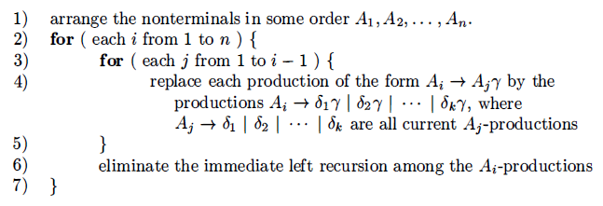
Elimination of Left Recursion...
METHOD:

Slide 66
Elimination of Left Recursion...
Ex. S → A a | b
A → A c | S d | ɛ
Technically, the algorithm is not guaranteed to work, because of the ɛ-production but in this case, the production A → ɛ turns out to be harmless.
We order the non-terminals S, A.
For i = 1 nothing happens, because there is no immediate left recursion among the S-productions.

Slide 67
Elimination of Left Recursion...
For i = 2 we substitute for S in A → S d to obtain the following A-productions.
A → A c | A a d | b d | ɛ
Eliminating the immediate left recursion among these A-productions yields the following grammar:
S → A a | b
A → b d A’ | A’
A’ → c A’ | a d A’ | ɛ

Slide 68

Left Factoring
Left factoring is a grammar transformation that is useful for producing a grammar suitable for predictive, or top-down, parsing.
If two productions with the same LHS have their RHS beginning with the same symbol (terminal or non-terminal), then the FIRST sets will not be disjoint so predictive parsing will be impossible
Top down parsing will be more difficult as a longer lookahead will be needed to decide which production to use.
Ex.

Slide 69
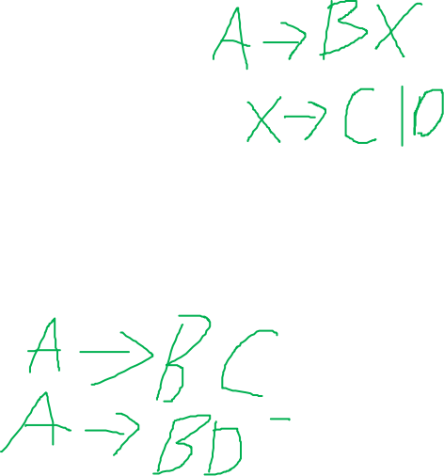
Left Factoring..
if A → αβ₁ | αβ₂ are two A-productions
Input begins with a nonempty string derived from α
We do not know whether to expand A to αβ₁ or αβ₂
However , we may defer the decision by expanding A to αA'
After seeing the input derived from α we expand
A' to β₁ or A' to β₂.
This is called left-factoring.
A → α A’
A' → β₁| β₂

Slide 70
Left Factoring…
INPUT: Grammar G.
OUTPUT: An equivalent left-factored grammar.
METHOD:
For each non-terminal A, find the longest prefix α common to two or more of its alternatives.
If α ≠ ɛ i.e., there is a nontrivial common prefix.
Replace all of the A-productions A → αβ₁ | αβ_{2 …} | αβ_{n} | γ by
A → α A’ | γ
A' → β₁| β₂| …. | β_{n}
γ represents all alternatives that do not begin with α

Slide 71


Left Factoring…
Ex Dangling else grammar:
Here i, t, and e stand for if, then, and else E and S stand for "conditional expression" and "statement."
Left-factored, this grammar becomes:

Slide 72
x+y=3
x-y=2

